Slide 1
Examination System
To: Dr. Mahmoud A. Saber
By: Abdel-Rahman Mohammed – Ahmed Hamdy – Muhammad Magdy

Slide 2
IDEA
An online examination system that involves students, staff and employees in a systematic and automatic examination procedure.
Exams are made online and the student can access it remotely at any time of the day.
Exams are evaluated manually by the system which returns the results immediately to the student and report back to the staff member of this result

Slide 3
Student
When a student signs in, he’s able to:
View His profile.
Take a new exam.
View the results of his past exams
The student signs in the website to take any exam of the courses he takes according to his department.
If a student chooses take exam, a random exam will be generated from the question bank and the exam will have a limited time.
When a student submits his answers, he will be able to view the result of the exam or any other exam he took.

Slide 4
Student Cont.
When a student signs in, he’s able to:
View His profile.
Take a new exam.
View the results of his past exams
When a student submits his answers, he will be able to view the result of the exam or any other exam he took.
A student is able to view his information in his profile and can also add a photo of himself

Slide 5
Staff Member
When a staff signs in, he’s able to:
Add Questions.
View the stats of the past taken exams and the percentage of the succeeded students
A staff member can add up to three different types of questions:
MCQ.
True or False.
Complete.

Slide 6
Staff Member Cont.
When a staff signs in, he’s able to:
Add Questions.
View the stats of the past taken exams and the percentage of the succeeded students
In stats page, a staff member can view the number of exams which has been taken and the average grades of the students in every course he manages.

Slide 7
Employee
When an employee signs in, he’s able to:
Add different courses.
Add new Students.
New courses can be added based on the different departments and levels.
When a new course is added, its midterm exam and final exam points are specified and takes a unique ID
An employee can also edit the existing course list, he can delete from the list and add the same course with the required new specifications in order to edit an existing one.

Slide 8
Employee Cont.
When an employee signs in, he’s able to:
Add different courses.
Add new Students.
An employee can add new students to the student list.
To register a new student, he should provide his name, SSN, Email address and password
An employee can also edit the existing student list, he can delete from the list and add the same student with the required new information in order to edit an existing one.

Slide 9
Used Tools and languages
Front-end:
In front end we used:
Basic html.
CSS (Cascaded Style Sheets).
JavaScript.

Slide 10
Used Tools and languages
Back-end:
In Back-end we used Nodejs to handle the requests and responses from the server side and to manage the database.
We studied Nodejs from the beginning, it was self learning and we didn’t use any frameworks to achieve the required features.

Slide 11
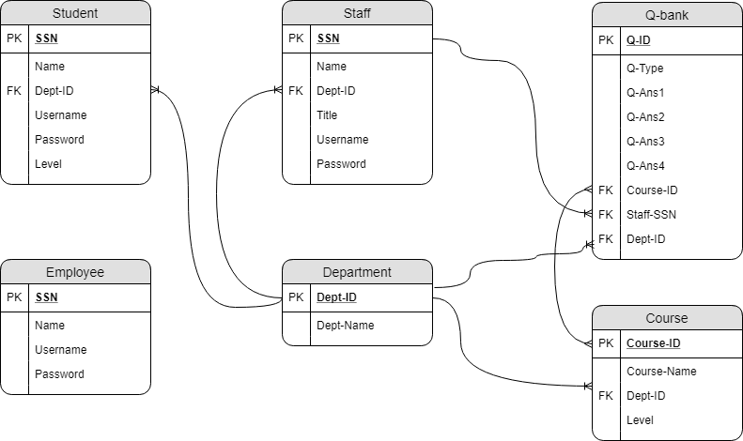
Database
This is the ERD of the designed database

Slide 12
Database
To maintain the data in our server we used DBMS of SQL.
SQL (Structured Query Language) is used to access, retrieve and edit databases.
Our database is made of 6 tables, each table represents an entity.

Slide 13
Thanks
References:
www.w3schools.com www.tutorialspoint.com
www.stackoverflow.com www.github.com

